Slide 1
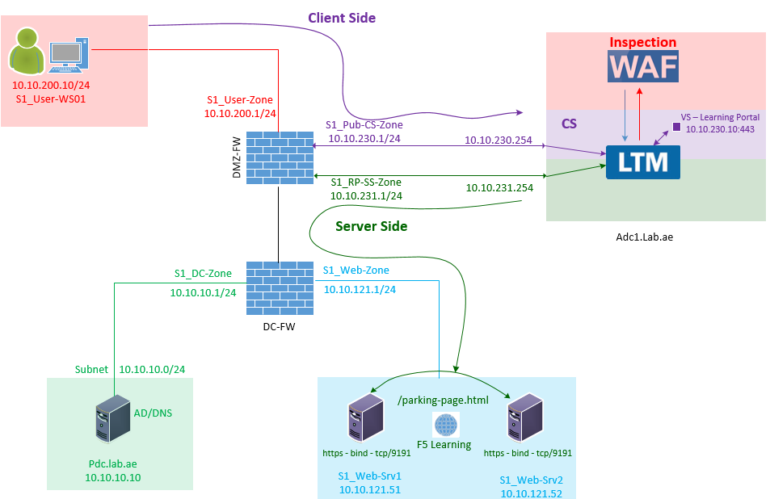


F5 LTM Learning with
Alexander S
Bonus Chapter 08 - Explore and configure the One Connect profile in F5 LTM
SNAT_Pool : 10.10.231.10
Generic_OneConnect_Profile

Slide 2
What is a One Connect Profile in F5 LTM?
(When F5 works as a Full proxy SNAT is Mandatory)
F5 operates as a full reverse proxy.
As part of this full proxy architecture:
  F5 receives and terminates the client TCP connection on the Virtual Server IP, which is configured on the client-side VLAN.
  It then performs security inspection using Web Application Firewall (WAF).
  If the request passes the security inspection and is determined to be legitimate than F5 creates a new, separate TCP connection to the backend server.
  Typically, this server side connection uses SNAT - so that the server returns its response to F5 instead of sending directly to the client.
  SNAT is impartment to avoid Asymmetric Routing issue.
SNAT_Pool : 10.10.231.10
Generic_OneConnect_Profile

Slide 3
To understand SNAT, You can watch this video.
https://www.youtube.com/watch?v=gey2EDb_-2M

Slide 4
What is a One Connect Profile in F5 LTM?
(Each client connection is tied to its own server-side connection)
We are going to explore how F5 creates a server-side connection on behalf of the client.
Without a One Connect profile, F5 maintains a one-to-one relationship between the client-side and server-side connections.
For example:
  5 clients connect to the Virtual Server.
  For Each Client Request - F5 establishes 5 separate TCP connections to the backend server using the SNAT IP.
  It means, Each client connection is tied to its own server-side connection until the connection is closed.
SNAT_Pool : 10.10.231.10
Generic_OneConnect_Profile

Slide 5
What is a One Connect Profile in F5 LTM?
(What is the problem in one-to-one client/server connections?)
As the number of client connections increases, the number of server-side connections also increases.
This can consume additional server resources, including memory, CPU and available TCP sockets.
SNAT_Pool : 10.10.231.10
Generic_OneConnect_Profile

Slide 6
What F5 Can do on This???
(Changes in Server-Side Connection Creation Behavior)
(Five Clients Reuses Two Tcp connection)
The One Connect profile in F5 BIG-IP is used to reuse server-side TCP connections for multiple client requests instead of creating a new connection each time.
SNAT_Pool : 10.10.231.10
Generic_OneConnect_Profile

Slide 7
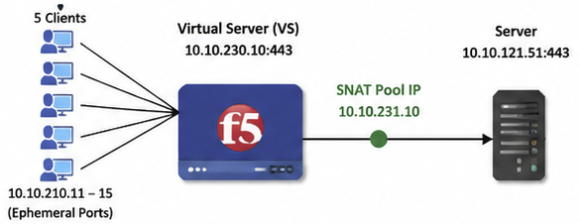
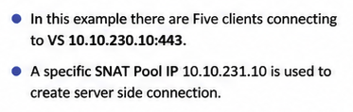
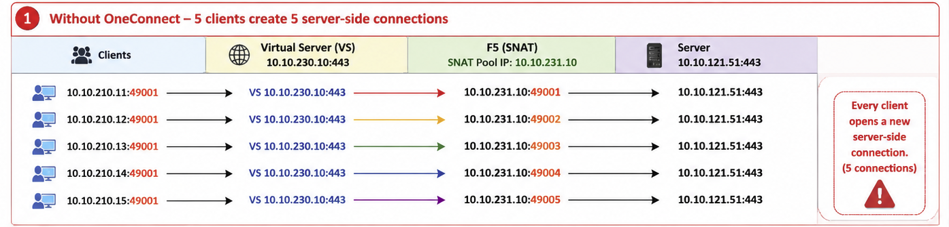
Without One Connect
(Without one connect 5 clients creates 5 server side connection)

Slide 8
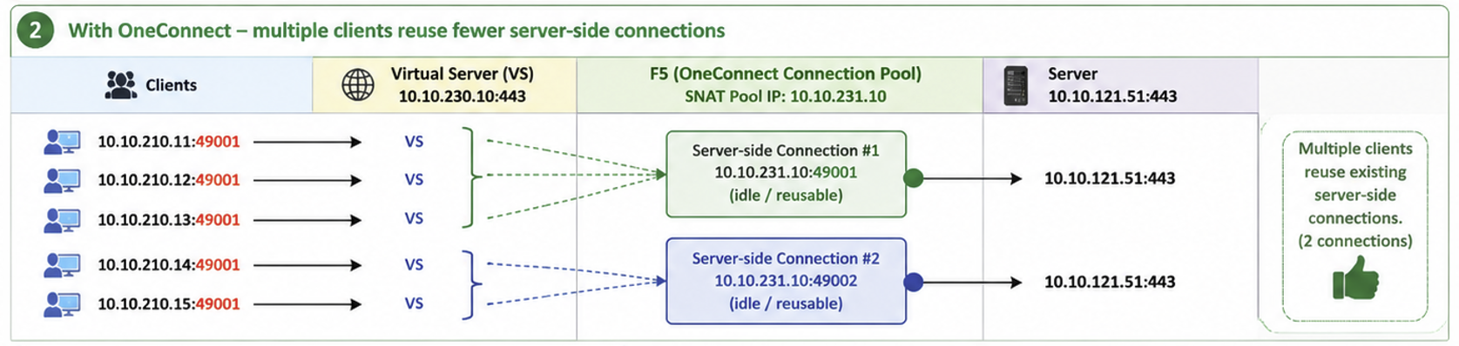
What One Connect Does?
(With one connect – Multiple Clients reuse fewer server-side connections)
With One Connect enabled,
F5 maintains a pool of reusable server-side connections.
This allows multiple client requests to share the same server side connection.
Additionally, you can specify a source mask to control which clients are eligible to reuse these connections.

Slide 9
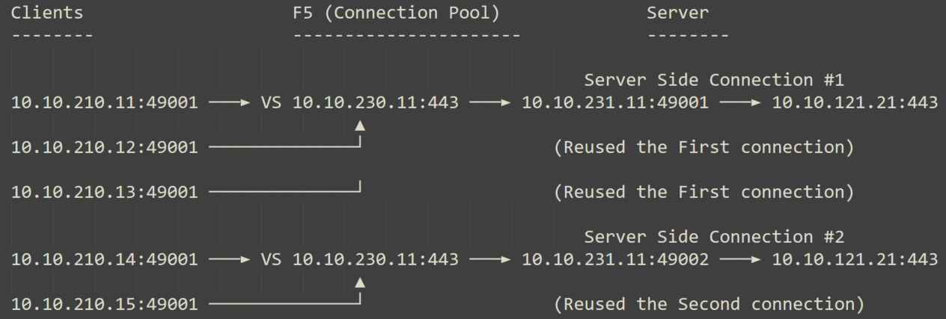
Why One Connect is needed in F5 LTM?
(With one connect – Multiple Clients reuse fewer server-side connections)
The first server-side connection is created when the first client connects.
When the second client connects:
  If the load balancing algorithm selects the same backend server for the second client, and also if the existing server-side connection is available (idle), then the second client reuses the existing server-side connection.
  In this example, the first three clients reuse Server-side Connection #1, while the last two clients reuse Server-side Connection #2.

Slide 10
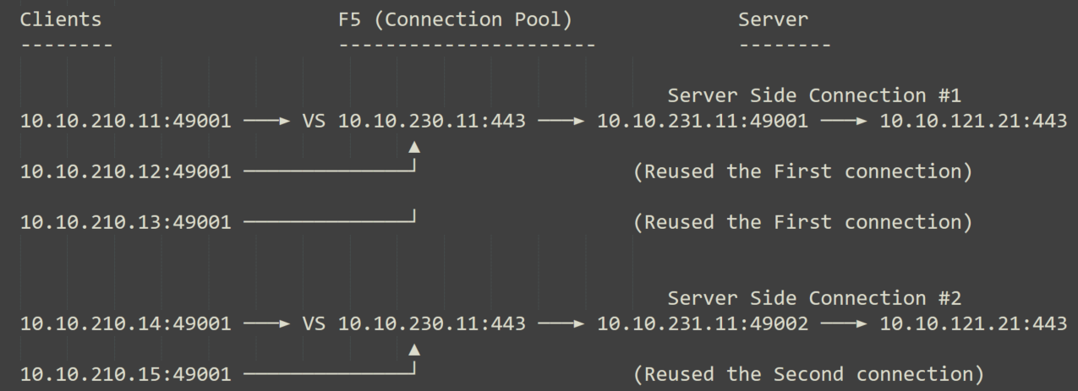
Why One Connect is needed in F5 LTM?
(With one connect – Multiple Clients reuse fewer server-side connections)
The first server-side connection is created when the first client connects.
When the second client connects:
  If the load balancing algorithm selects the same backend server for the second client, and also if the existing server-side connection is available (idle), then the second client reuses the existing server-side connection.
  In this example, the first three clients reuse Server-side Connection #1, while the last two clients reuse Server-side Connection #2.
This reduces
Server load
TCP handshake overhead
Resource usage

Slide 11
Configure the One Connect profile in F5 LTM
Let us configure the one connect profile in F5 LTM.
Name: Generic_OneConnect_Profile
SNAT_Pool : 10.10.231.10
Generic_OneConnect_Profile

Slide 12

One Connect Source Prefix Length
(Source Prefix Length determines which client IP addresses are allowed to reuse the same server-side connection)
The value length must be set "the number of set bits" in a bitmask,
Specifically,
between 0 and 128 for IPv6, or
between 0 and 32 for IPv4.
The default value is None.

Slide 13
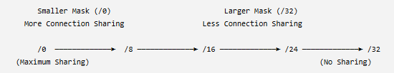
One Connect Source Prefix Length
(Source Prefix Length determines which client IP addresses are allowed to reuse the same server-side connection)
For example - In IPv4
  Smaller Mask means more Connection Sharing
  Larger Mask means less Connection Sharing.

Slide 14

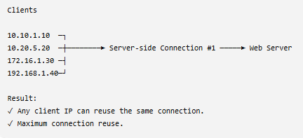
One Connect Source Mask
(Source Prefix Length = 0)
No source IP restriction.
All client IP addresses belong to the same reuse group.
Any client is eligible to reuse an existing idle server-side connection

Slide 15

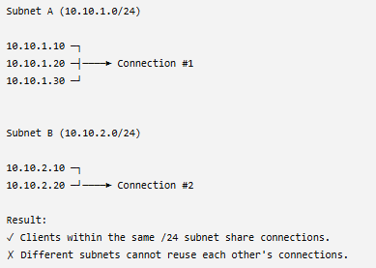
One Connect Source Mask
(Source Prefix Length = 24)
Only clients within the same /24 subnet belong to the same reuse group.
Clients from different subnets do not share server-side connections.

Slide 16

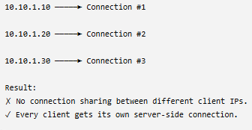
One Connect Source Mask
(Source Prefix Length = 32)
Each client IP address forms its own reuse group.
Server-side connections are reused only by the same client IP.
Different client IP addresses cannot share server-side connections.

Slide 17
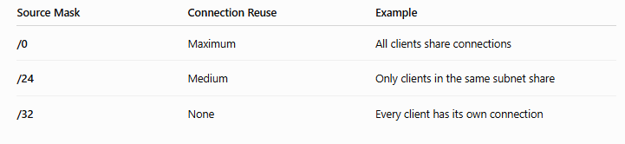
One Connect Source Mask
(Source Prefix Length Summary)

Slide 18
Bonus Chapter 08 - Explore and configure the One Connect profile in F5 LTM
I hope this video helped you understand and configure One-Connect Profile in F5.
Later when you configure the Virtual Server - You will assign this one-connect profile to reduce the server load.
This brings us to the end of Bonus Chapter 08.
Thank you for watching !!!
SNAT_Pool : 10.10.231.10
Generic_OneConnect_Profile

